Slide 1

DECOS
2/6/2024

Slide 2
Update: 2023-2024 Initiatives
Completed:
DE component of the 2025-2035 Master
Update Distance Learning Addendum (now in use)
Draft and distribute guidelines to prevent fraudulent enrollments
In progress:
Develop an online teaching maintenance plan
Propose updated DE faculty qualifications

Slide 3
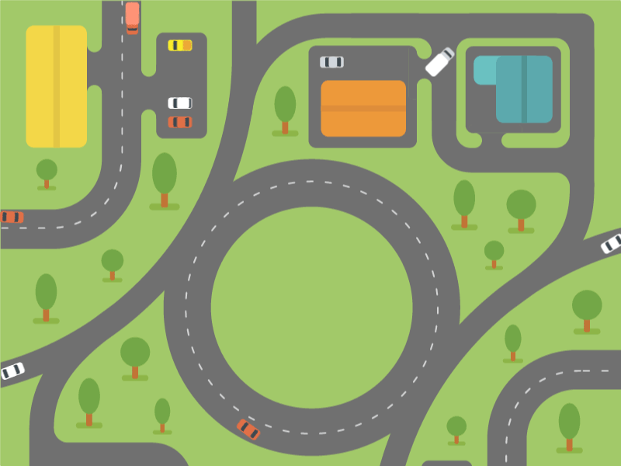
The
Road Ahead
DECOS
Ed Tech Committee
Academic Senate
?

Slide 4
The Proposal (in brief)
New/First-time Online Certifications:
Complete a truncated COS-custom @ONE Online Teaching & Design course (40-60 hrs.) before an online assignment. Provision made for those who must teach online immediately.
Already/Outside Certified:
FT: take above program within 4 yrs. OR submit a course for local CVC-OEI rubric review.
PT: present evidence of outside training dated within 4 yrs. Can teach concurrently.
Maintenance of Certification:
4-year cycle. Given notice at 1 year to expiration.
Complete BOTH of the following:
8 hrs. of DE-related professional development per cycle (~2 hours per year) AND
Submit any online course within the past 4 years for feedback-focused review (non-evaluative)

